Slide 1
OOP Final Project
May 13, 2025

Slide 2
Agenda
Main Methods
OOP Fundamentals
Timeline
Prototype demonstration
Improvements

Slide 3

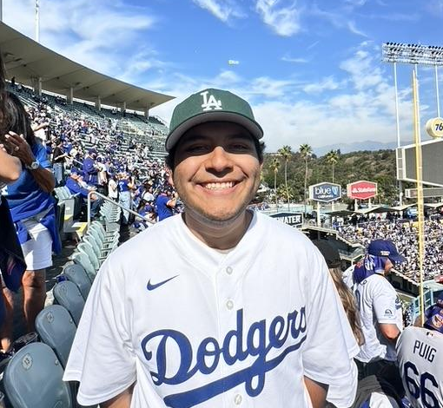
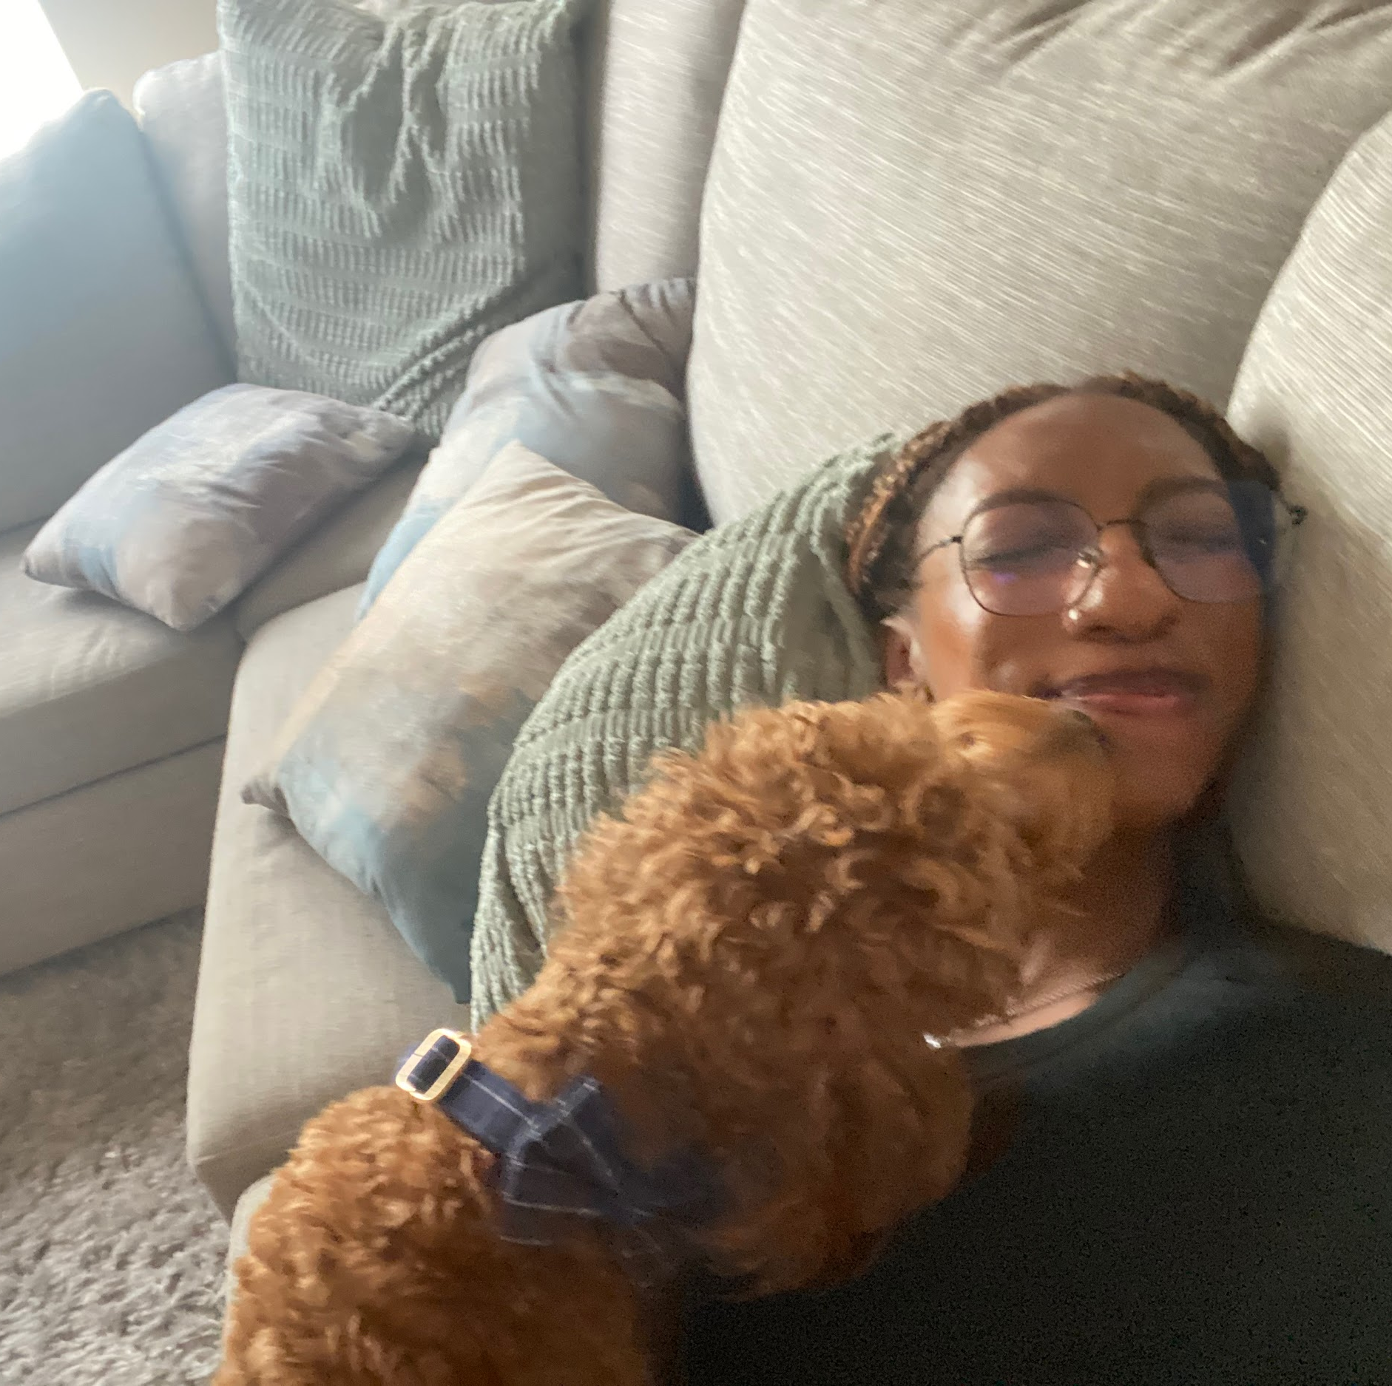
Presenters
Sterling Vieau
Adrian Salcedo
UI Designer
Backend/Database Development
Cyenadi Greene
Security Notification

Slide 4
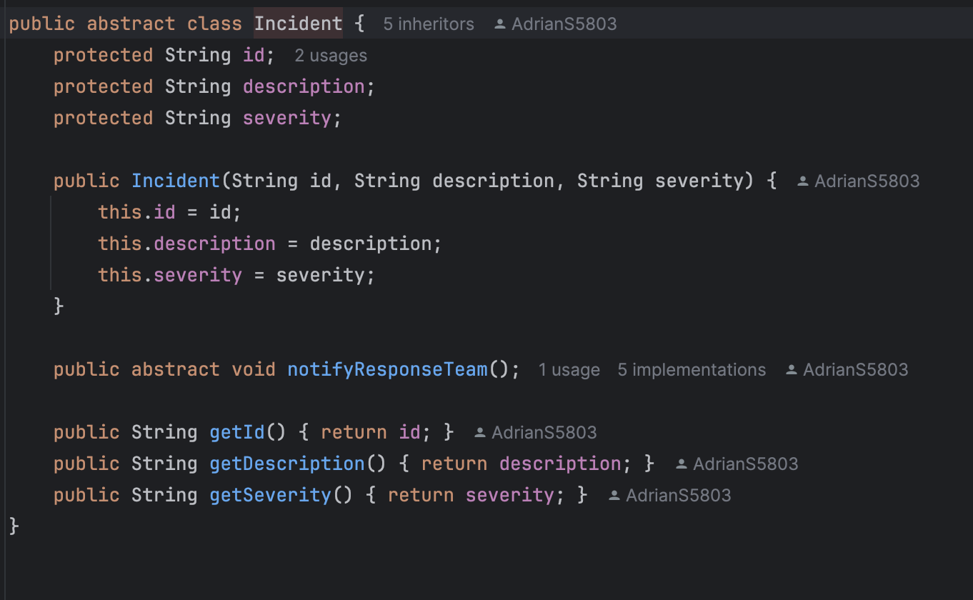
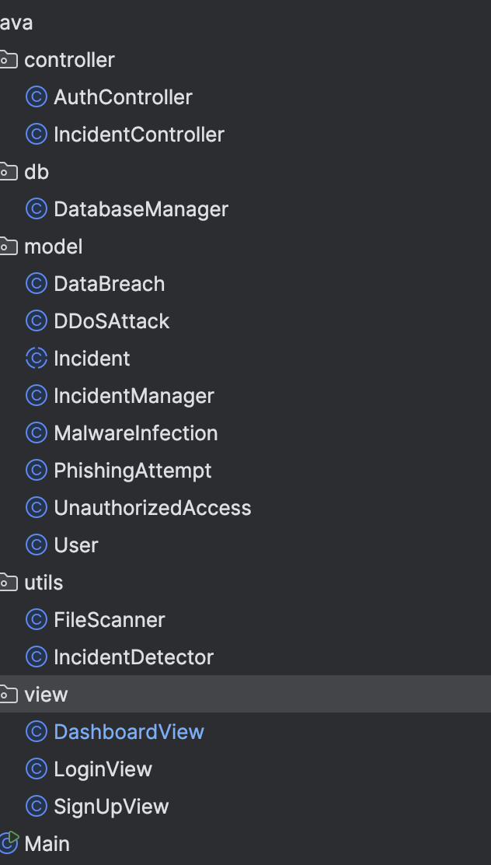
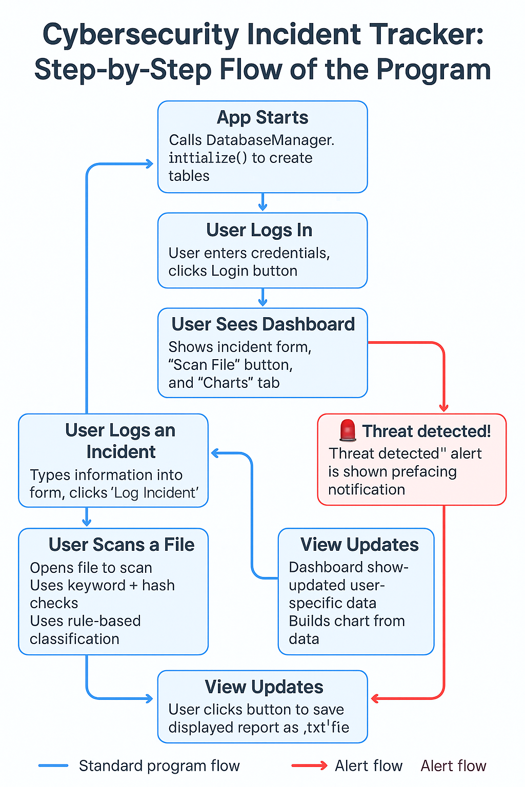
Main Packages
Controller
Model
Utils
View
Db(database)

Slide 5
OOP Fundamentals
Unveiled: Structuring Code
Inheritance:
Incident is an abstract base class Subclasses like DataBreach, PhishingAttempt, etc. inherit common fields and methods. This promotes code reuse and hierarchy
Polymorphism:
Incident incident = new PhishingAttempt(...)
incident.notifyResponseTeam() calls the correct version at runtime
Same method behaves differently depending on object type
Abstraction:
Incident defines abstract method notifyResponseTeam()
Hides implementation details — forces subclasses to define their own version
Lets you interact with all incidents through a common interface
Encapsulation:
Fields like username and passwordHash in User are private
Access is controlled via getters and methods like checkPassword()
Protects sensitive data and maintains integrity

Slide 6
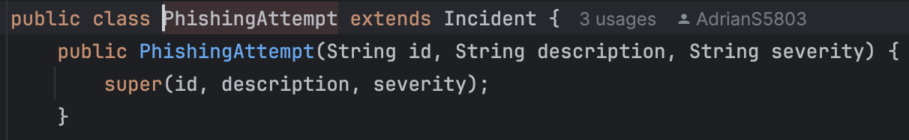
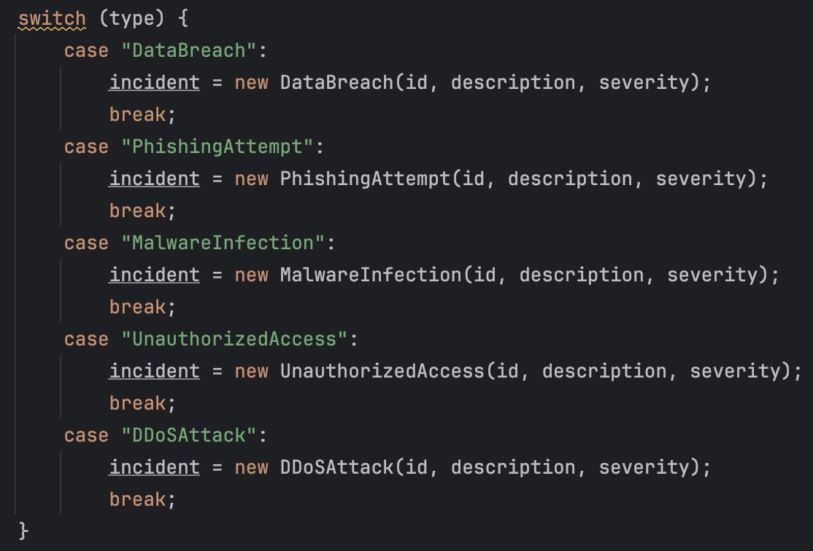
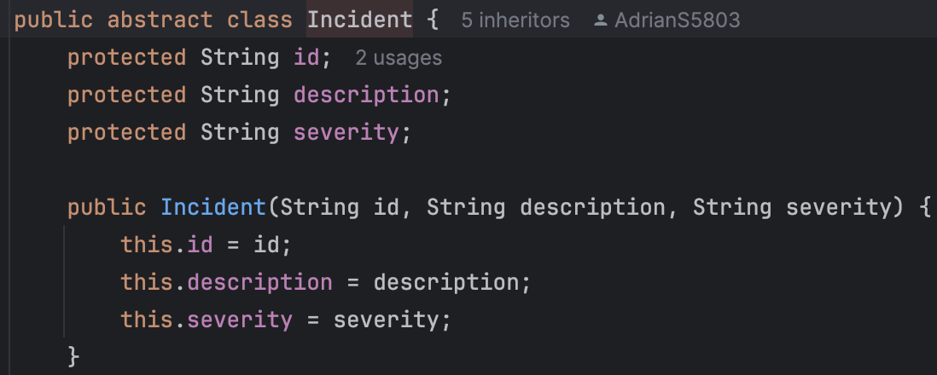
OOP Fundamentals
Inheritance:
Polymorphism:
Abstraction:

Slide 7
Timeline
February
March
April
May
Backend Code began to be implemented
UI Added
UI and backend code combined together
Finishing Touches
Project Initially Created

Slide 8
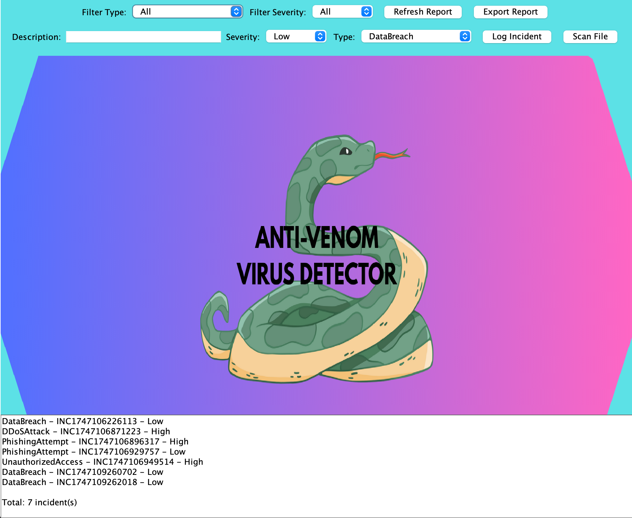
Screenshots of our Prototype
Send Security Reports.
Scan Files for viruses or suspicious contents.
Log specific security incidents.

Slide 9
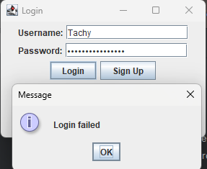
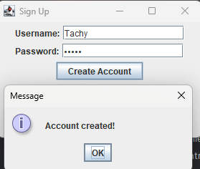
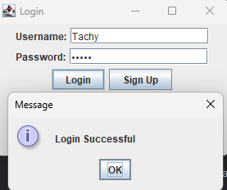
Prototype in Action
The initial login fails because we haven’t created an account
By clicking on sign up we are able to create and account
Now using the username and password from the sign up prompt we can successfully login.

Slide 10
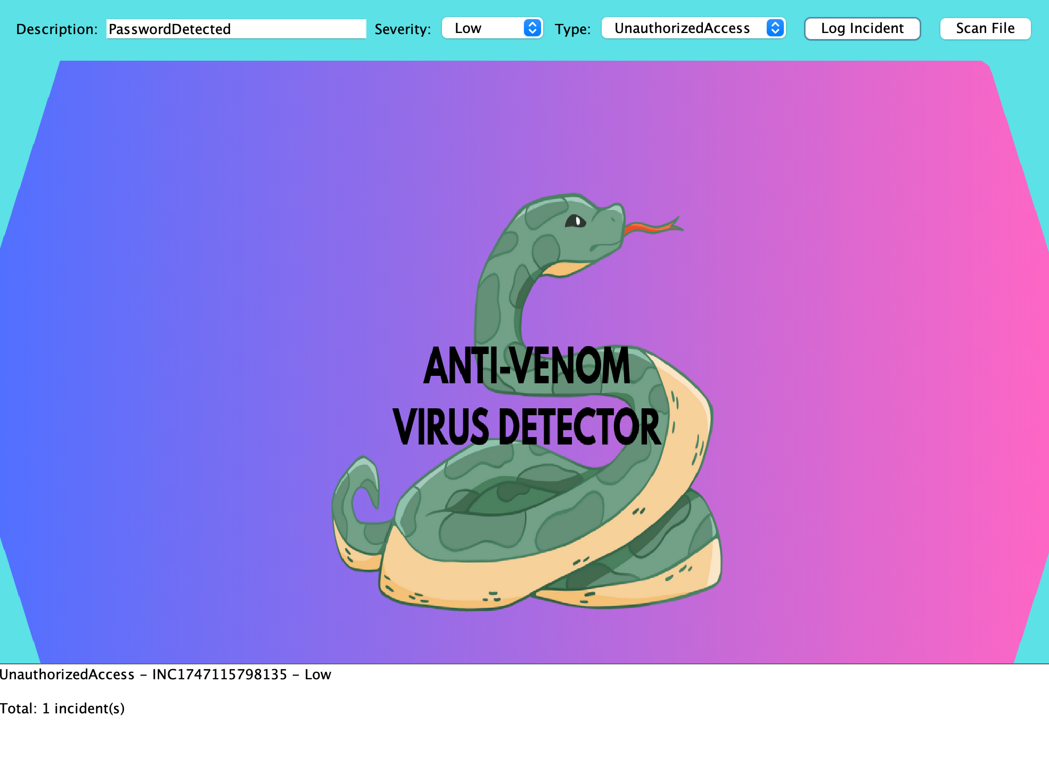
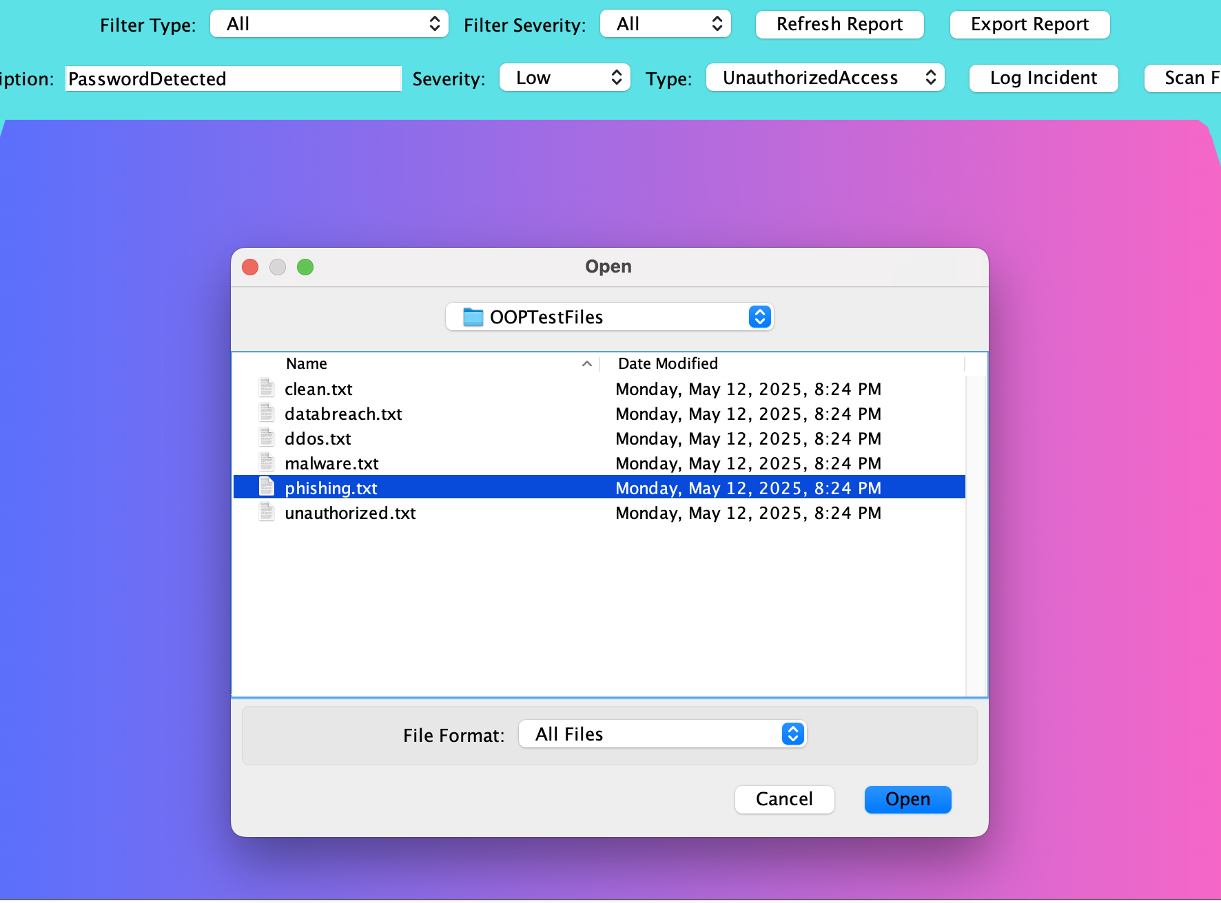
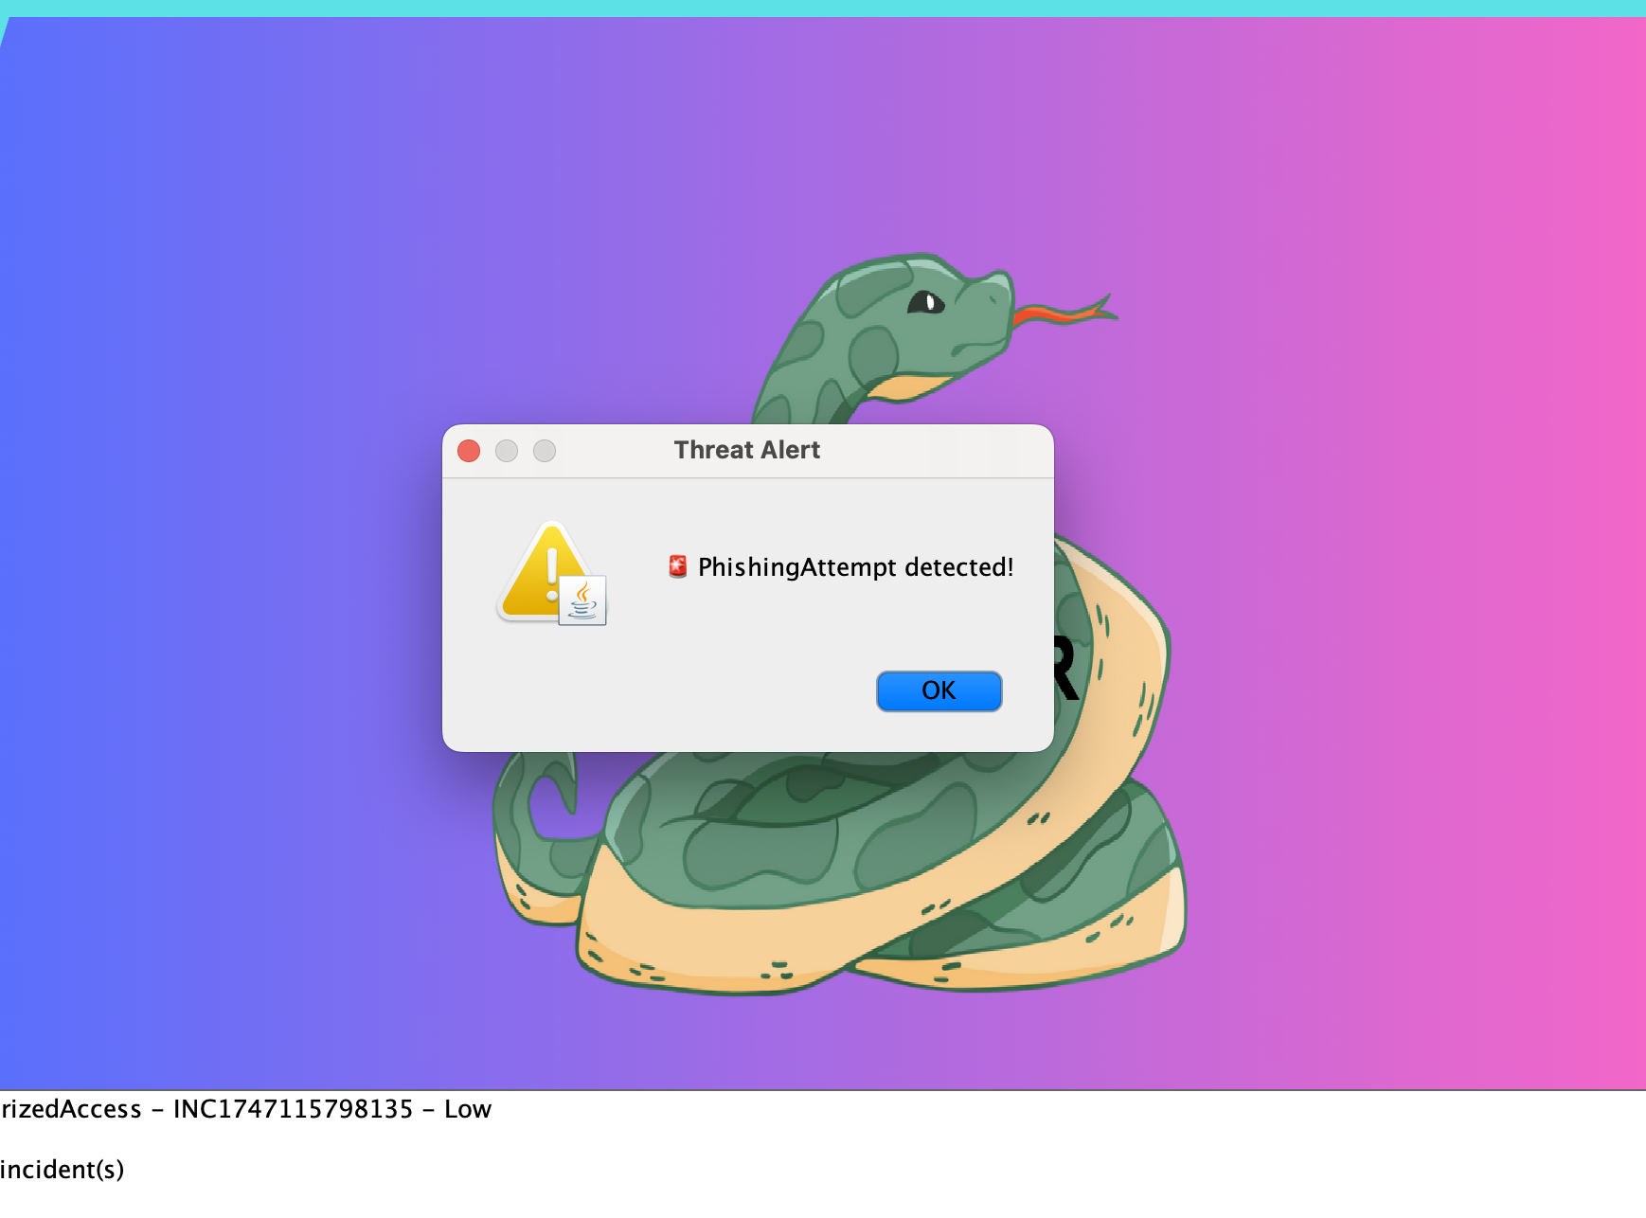
Prototype in Action (Continued)
To log in a security alert you can simply type in its description, set its severity level/type, and press log incident.
To check a particular file on you pc just press scan file and navigate to the file you want checked
After checking a particular file you will get the results of the scan.

Slide 11
Potential Improvements
1. User Roles & Permissions
Add Admin vs Regular user roles
Allow Admin to view all incidents, manage users
2. Data Encryption
Encrypt sensitive fields in the database (e.g., incident descriptions)
Add encrypted backups
3. Export to PDF / Charts
Export incident logs and charts as PDF
Save pie/bar chart images
4. Real-Time Detection
Add real-time monitoring of folders for suspicious activity
Add a malware scan to users device

Slide 12
Thank you

